Slide 1
Synergies and conflicts between multiple sustainability goals
Master‘s Thesis presentation – Jan Steinhauser
Supervised by Prof. Dr. Uwe Schneider (FNU, Hamburg University) Dr. Livia Rasche (FNU, Hamburg University)

Slide 2
How strong are synergies and conflicts between different planetary impacts of land use?
Created an agricultural sector model
Estimated 8 planetary impact indicators in 6 different scenarios
Compared scenario impacts to find impact interactions

Slide 3
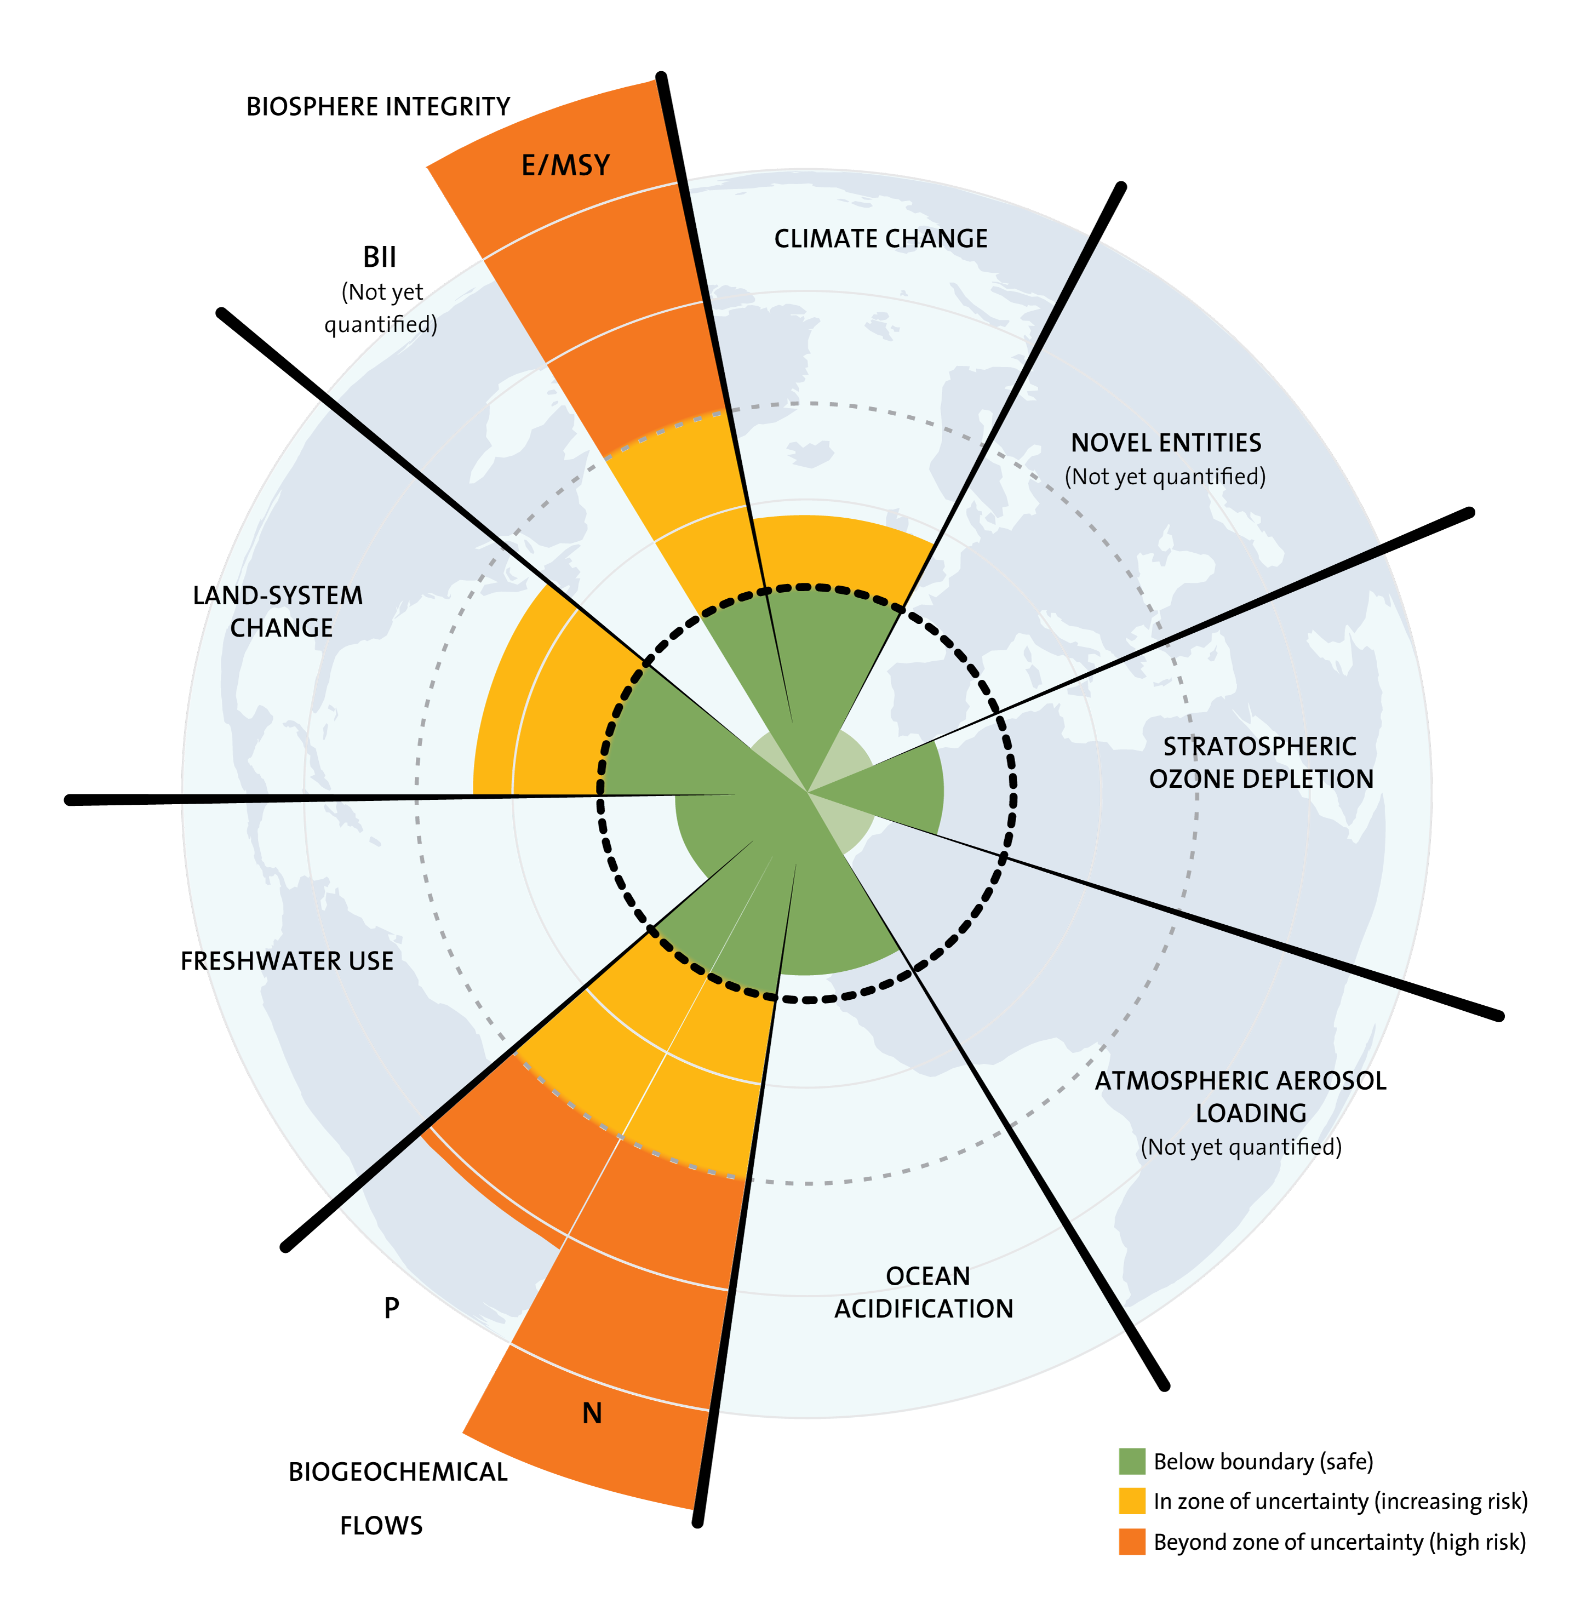
Planetary Boundaries
„Safe operating space for humanity“ (Rockström et al., 2009)
Critical Earth systems at risk of tipping into rapid change towards new stable states – both detrimental to human development and wellbeing
Five boundaries considered: climate change, biosphere integrity, land-system change, freshwater use, biogeochemical flows
Rockström et al. (2009)

Slide 4
Planetary Impacts
 | Rockström et al. (2009) | Model
Climate Change | Atmospheric CO₂ (ppm), radiative forcing | Net GHG emissions (CO₂eq)
Biosphere Integrity | Extinction rate | Loss of ecosystem quality
Land-system change | Share of cropland | Cropland, deforestation, afforestation
Freshwater use | Consumption of water | Consumption of water
Biogeochemical flows | Anthropogenic nitrogen fixation | Anthropogenic nitrogen fixation
 | Anthropogenic phosphorus input into ocean | Anthropogenic phosphorus application

Slide 5
Model + DATA
6 taxed externalities, 1 per scenario
Global scale (28 EU countries + 5 rest of the world regions)
2015–2050 (5-year steps)
34 raw and processed crop and livestock products
5 management types
conventional, organic, extensive (permaculture)
Rainfed, irrigated
Data: Primarily FAOSTAT + IIASA SSP

Slide 6
Model structure – Objective
Cropland
GHG emissions
Fixated synth. nitrogen
Storage
Processes
Biodiversity loss
Phosphorus application
Consumption
-
-
Trade
Livestock
Freshwater use
Deforestation
Revenue
Cost
Externality taxes

Slide 7

Model structure – Objective
Revenue
Crop
Livestock
$$W=\sum_{t,r,p}{\left(z_{r,p}∙Q_{t,r,p}\right)}−\sum_{t,r,c,m}{\left(c_{r,c}^{c}∙c_{m}^{m}∙C_{t,r,c,m}\right)}−\sum_{t,r,l}{\left(c_{r,l}^{l}∙L_{t,r,l}\right)} \\ −\sum_{t,r,q}{\left(c_{r,q}^{q}∙P_{t,r,q}\right)}−\sum_{t,r^{′},r,p}{\left(z_{r,p}∙0.15∙T_{t,r^{′},r,p}\right)} \\ −\sum_{t,r,p}{\left(z_{r,p}∙\left(0.01∙\left(S_{t,r,p}^{+}+S_{t,r,p}^{−}\right)+0.03∙S_{t,r,p}^{L}\right)\right)} \\ −\sum_{t,r,e}{\left(t_{e}∙E_{t,r,e}\right)}$$
max
Processes
Trade
Storage
Externalities
Capitals: variables Lower case: parameters
Subscript: sets

Slide 8
Model structure – Product balance
Crop management
Crop products
Storage
Crop Mix
Cropland
Processes
Process (by-)products
Consumption
kcal Corridor
Live Mix
Livestock
Livestock products
Trade

Slide 9
Model structure – Land use
Pasture management
Pasture
Other/Forest
LM/LMC
Livestock
Land evolution corridor
LU/LUC
Population
Urban
Cropland
Land Constraints
Helper Variables

Slide 10
Model structure – Indicators
GHG emissions
Livestock
Trade
Fixated synth. nitrogen
Biodiversity loss
LU/LM LUC/LMC
Cropland
Crop management
Phosphorus application
Deforestation
Afforestation
Freshwater use

Slide 11
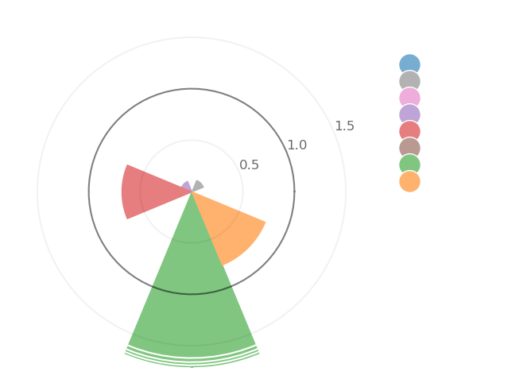
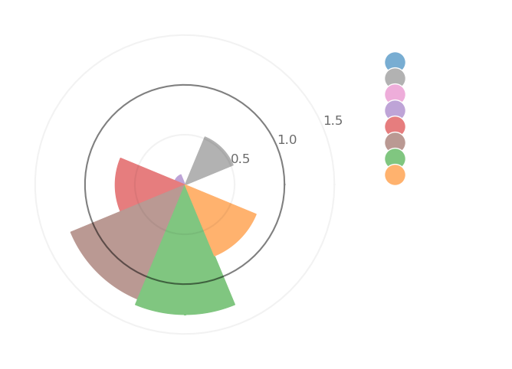
Results – GHG
6 Scenarios
1 Externality taxed and forced to unknown minimum
8 Planetary Impact indicators compared to normalized base scenario (1.0 ring)
Comparison of cross-behavior (B reacting to A-tax, A reacting to B-tax)

Slide 12
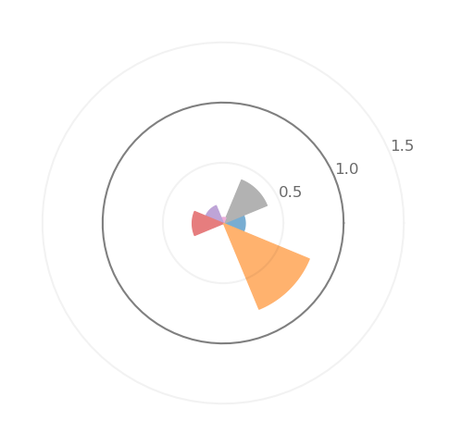
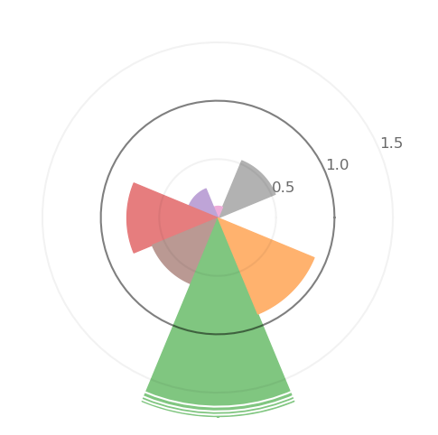
Results – strong Synergies
GHG
Biodiversity
Strong synergy (relative change > 20%) between GHG, biodiversity, water, and phosphorus
Mixed relation with land-system change
One-sided synergy with nitrogen
Water
Phosphorus

Slide 13
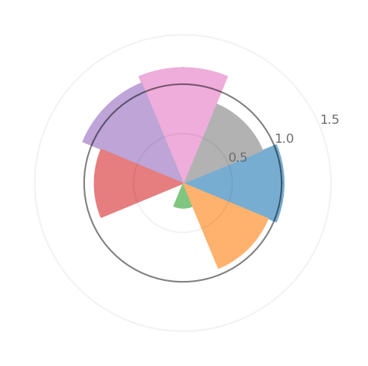
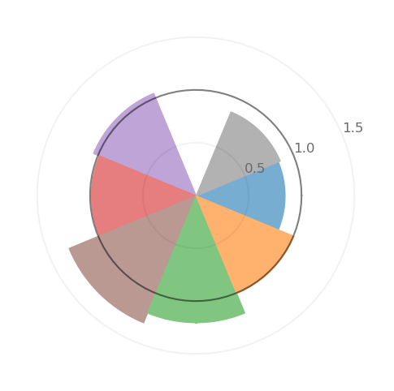
Results – No or weak synergies
Deforestation
Mostly weak relations in deforestation and nitrogen scenario (relative change < 20%)
Despite 90-130% relative change of nitrogen indicator in other scenarios
Nitrogen

Slide 14
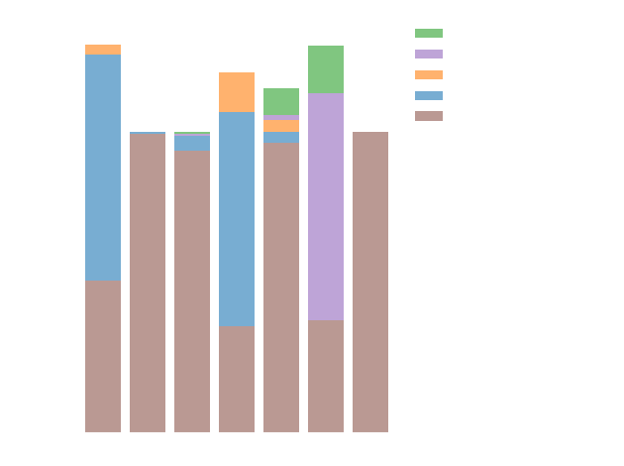
Results – Crop management
Crop reduction + shift to extensive management in synergetic scenarios
Extensive parameters:
GHG: 0-0.19
BDL: 0.65
Water: 0
N: 0
P: 0.1

Slide 15
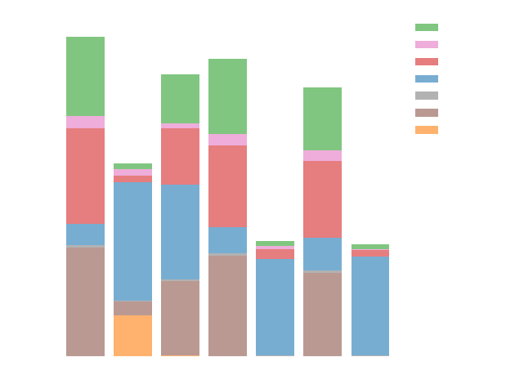
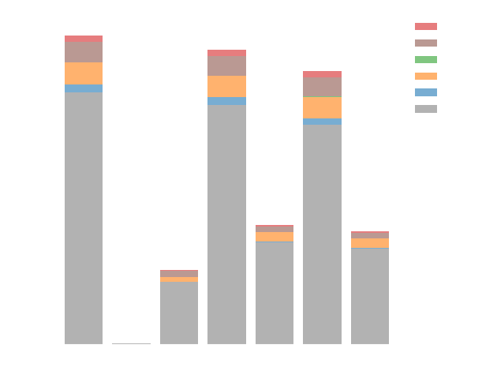
Results – Consumption
Crop products
Livestock products

Slide 16
How strong are synergies and conflicts between different planetary impacts of land use?
Strong synergies between GHG emissions, biodiversity loss, water use, and phosphorus application
Mixed behavior for land-system change and nitrogen fixation
Due to strong shift to extensive farming and unrealistic consumption mix
Future work: Investigate and correct the underlying assumptions
Thank you!

